Slide 1
JavaScript Frameworks with Episerver OPE
Drew Null
2018-05-22

Slide 2
JavaScript Frameworks with Episerver OPE JavaScript Frameworks without breaking Episerver OPE
Drew Null
2018-05-22

Slide 3
JavaScript Frameworks with Episerver OPE JavaScript Frameworks without breaking Episerver OPE JavaScript Libraries and Frameworks without breaking Episerver OPE
Drew Null
2018-05-22

Slide 4
JavaScript Frameworks with Episerver OPE JavaScript Frameworks without breaking Episerver OPE JavaScript Libraries and Frameworks without breaking Episerver OPE JavaScript Libworks? without breaking Episerver OPE
Drew Null
2018-05-22

Slide 5
JavaScript Frameworks with Episerver OPE JavaScript Frameworks without breaking Episerver OPE JavaScript Libraries and Frameworks without breaking Episerver OPE JavaScript Libworks? without breaking Episerver OPE JavaScript Framebraries? without breaking Episerver OPE
Drew Null
2018-05-22

Slide 6


Slide 7
2017

Slide 8
JavaScript Identity Crisis

Slide 9
JavaScript Identity Crisis (tools getting old, missing out on new things)

Slide 10
Episerver JavaScript Identity Crisis (tools getting old, missing out on new things)

Slide 11
CMS JavaScript Identity Crisis (tools getting old, missing out on new things)

Slide 12


Slide 13
What features do I want?

Slide 14
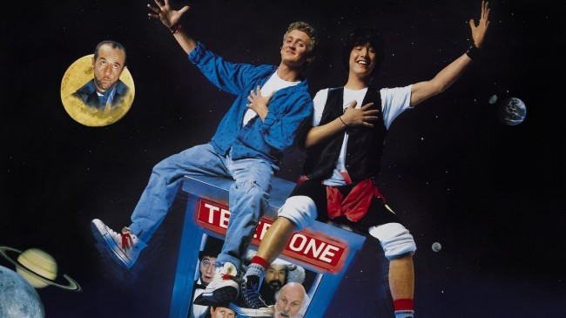

Slide 15

Easy DOM manipulation
$.ajax()
$.Deferred()

Slide 16

Easy DOM manipulation
$.ajax()
$.Deferred()
MVVM
(separation of concerns)
Observables
Custom bindings

Slide 17

Easy DOM manipulation
$.ajax()
$.Deferred()
MVVM
(separation of concerns)
Observables
Custom bindings
MVC
$location()
$http()
$q()
Directives and
components

Slide 18
Do work with ASP.NET MVC Razor -- Do not break Episerver OPE, personalization, or other things

Slide 19
What should I use today in 2018?

Slide 20
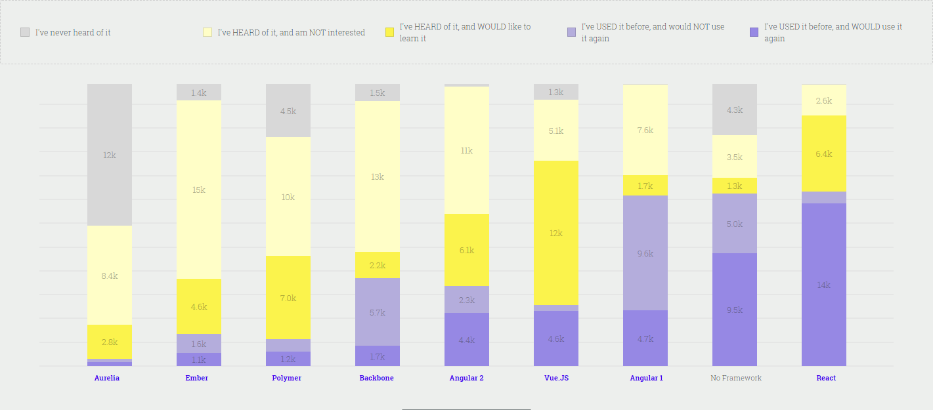
https://stateofjs.com/2017/front-end/results

Slide 21
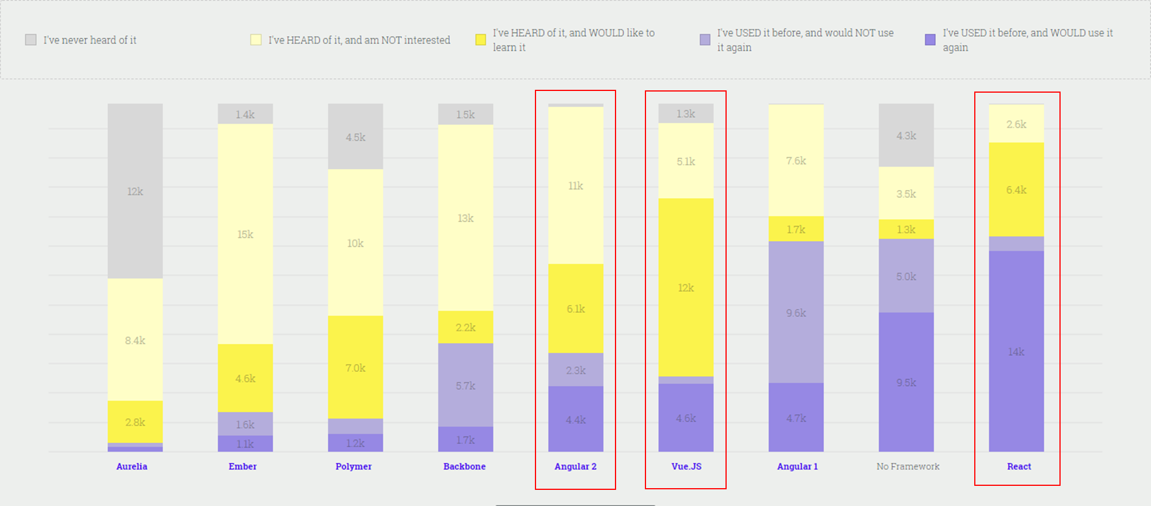
https://stateofjs.com/2017/front-end/results

Slide 22



Angular (2+)
Vue
React

Slide 23
How can I put them to the test?

Slide 24
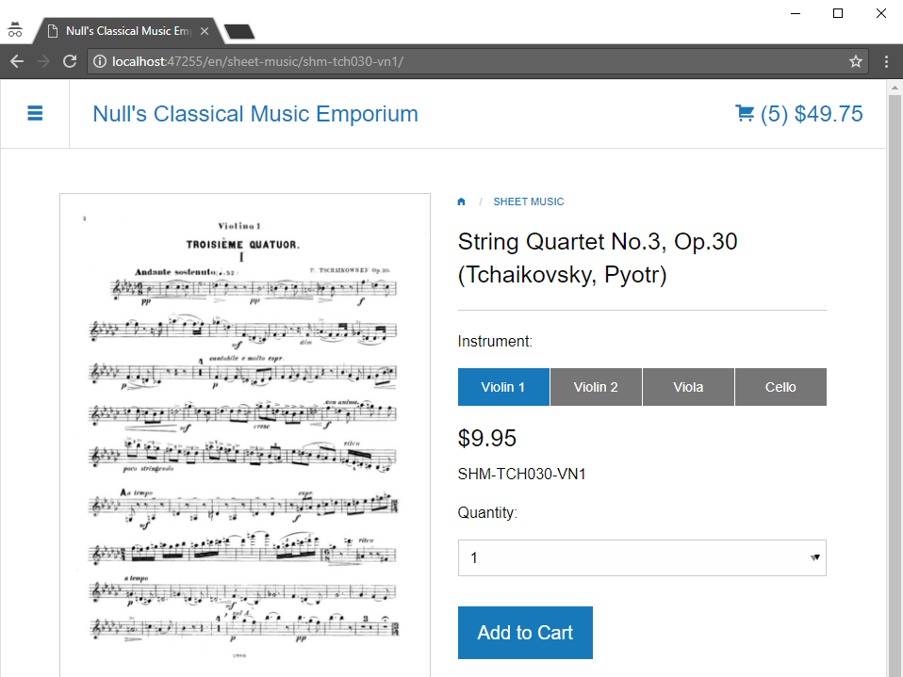

Slide 25
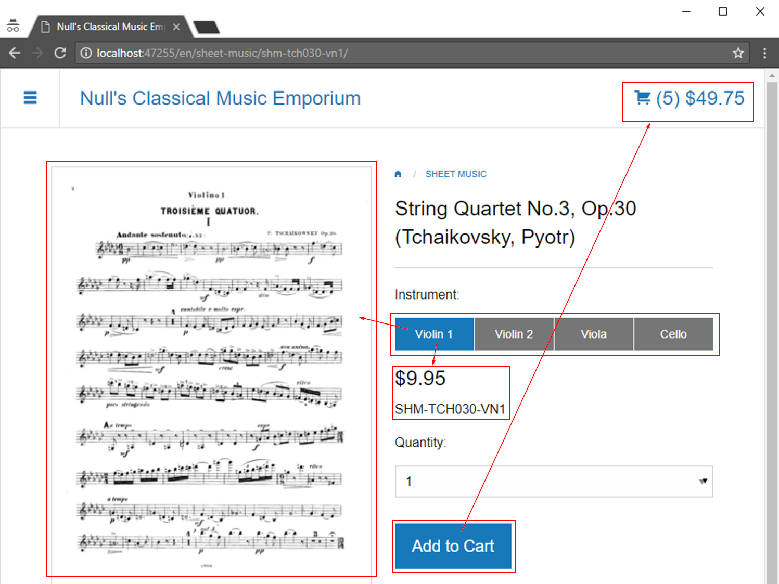
hmmm...

Slide 26
(code)

Slide 28
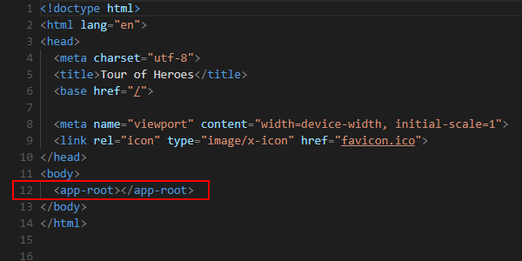

Slide 29
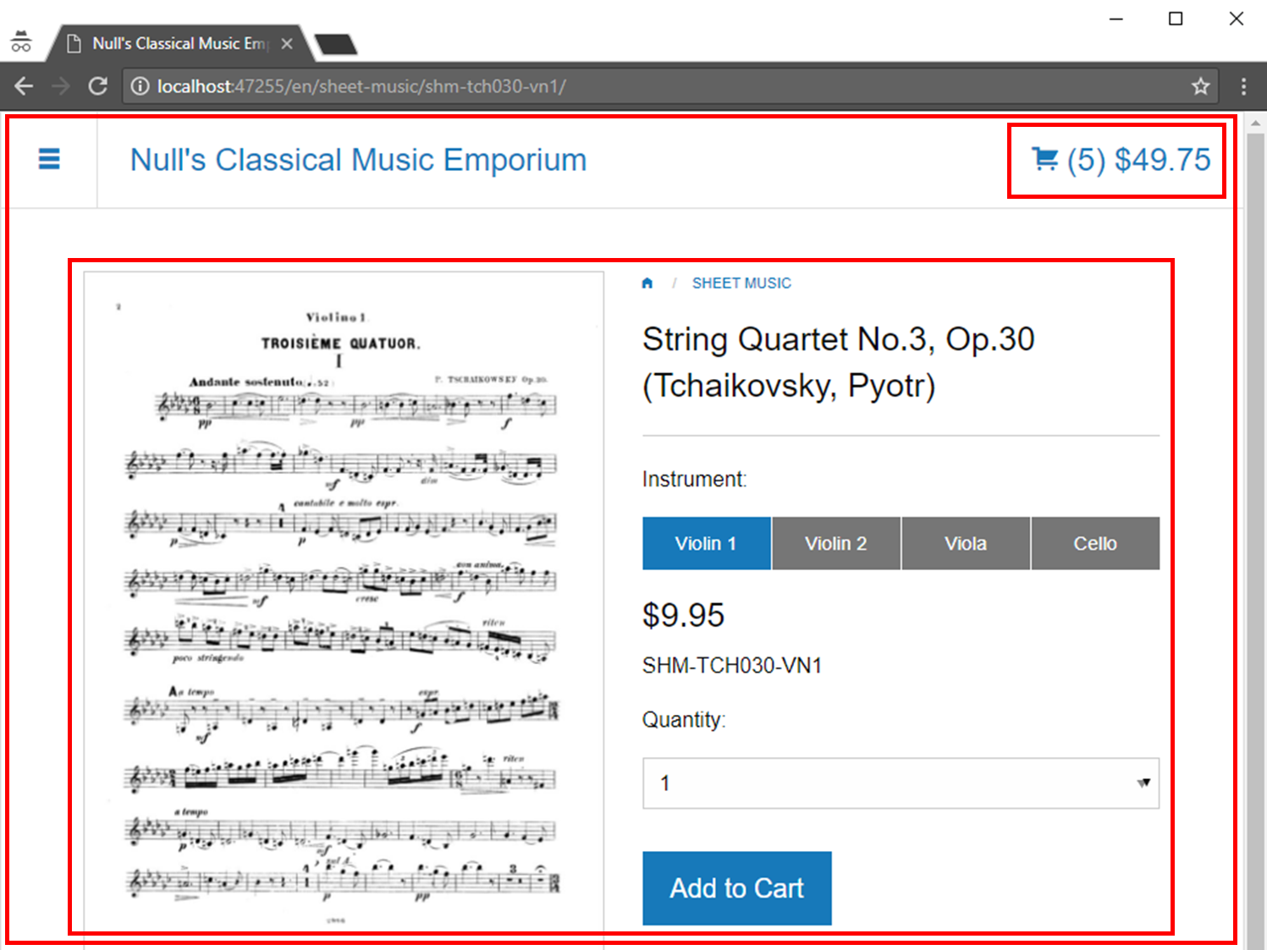

Slide 30
☹

Slide 32
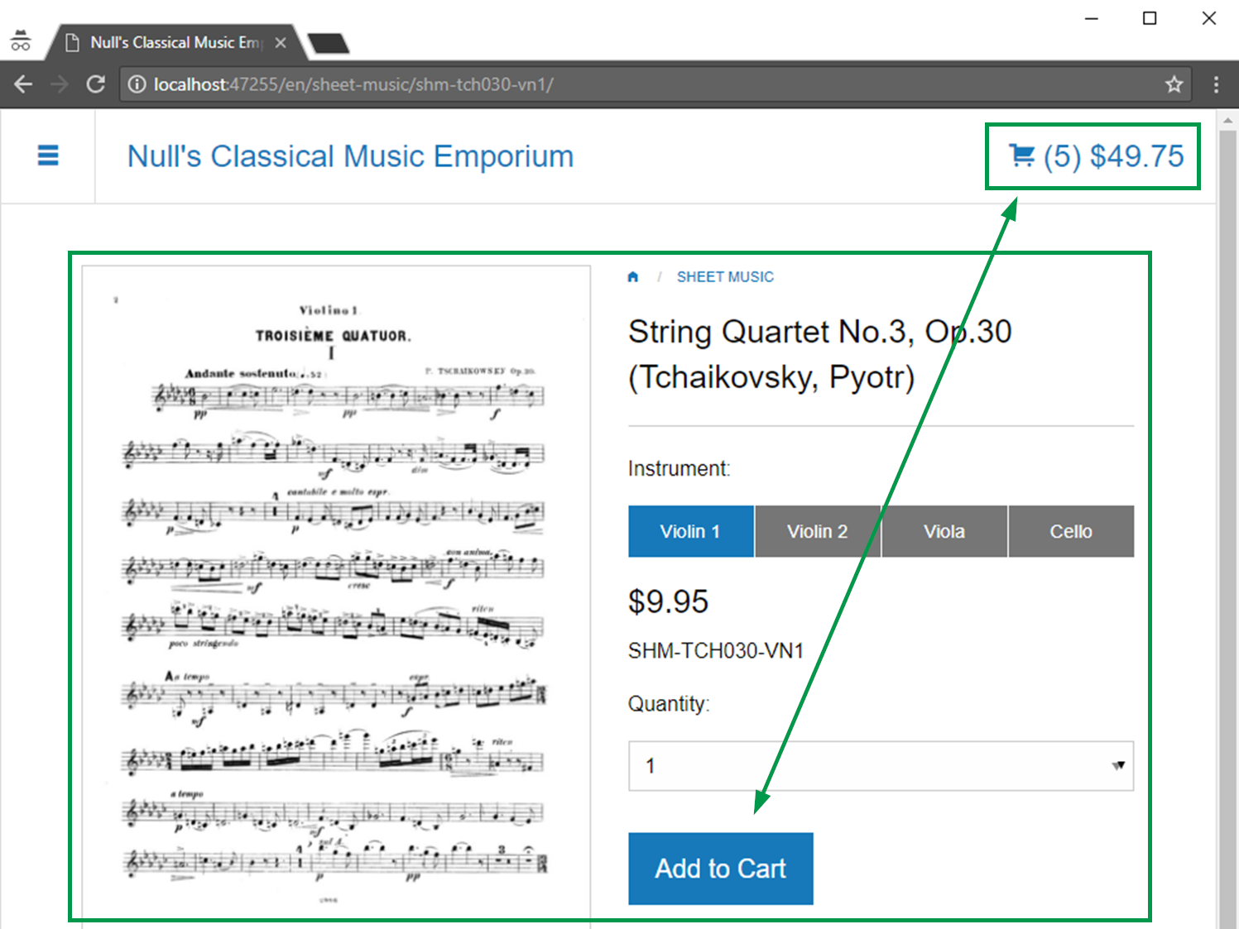

Slide 33
(code)

Slide 34
☹
☺

Slide 36
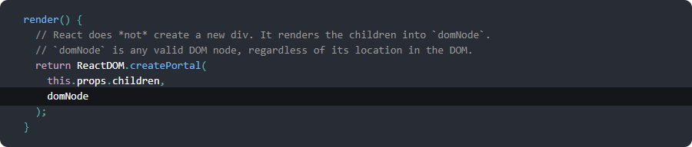

Slide 37
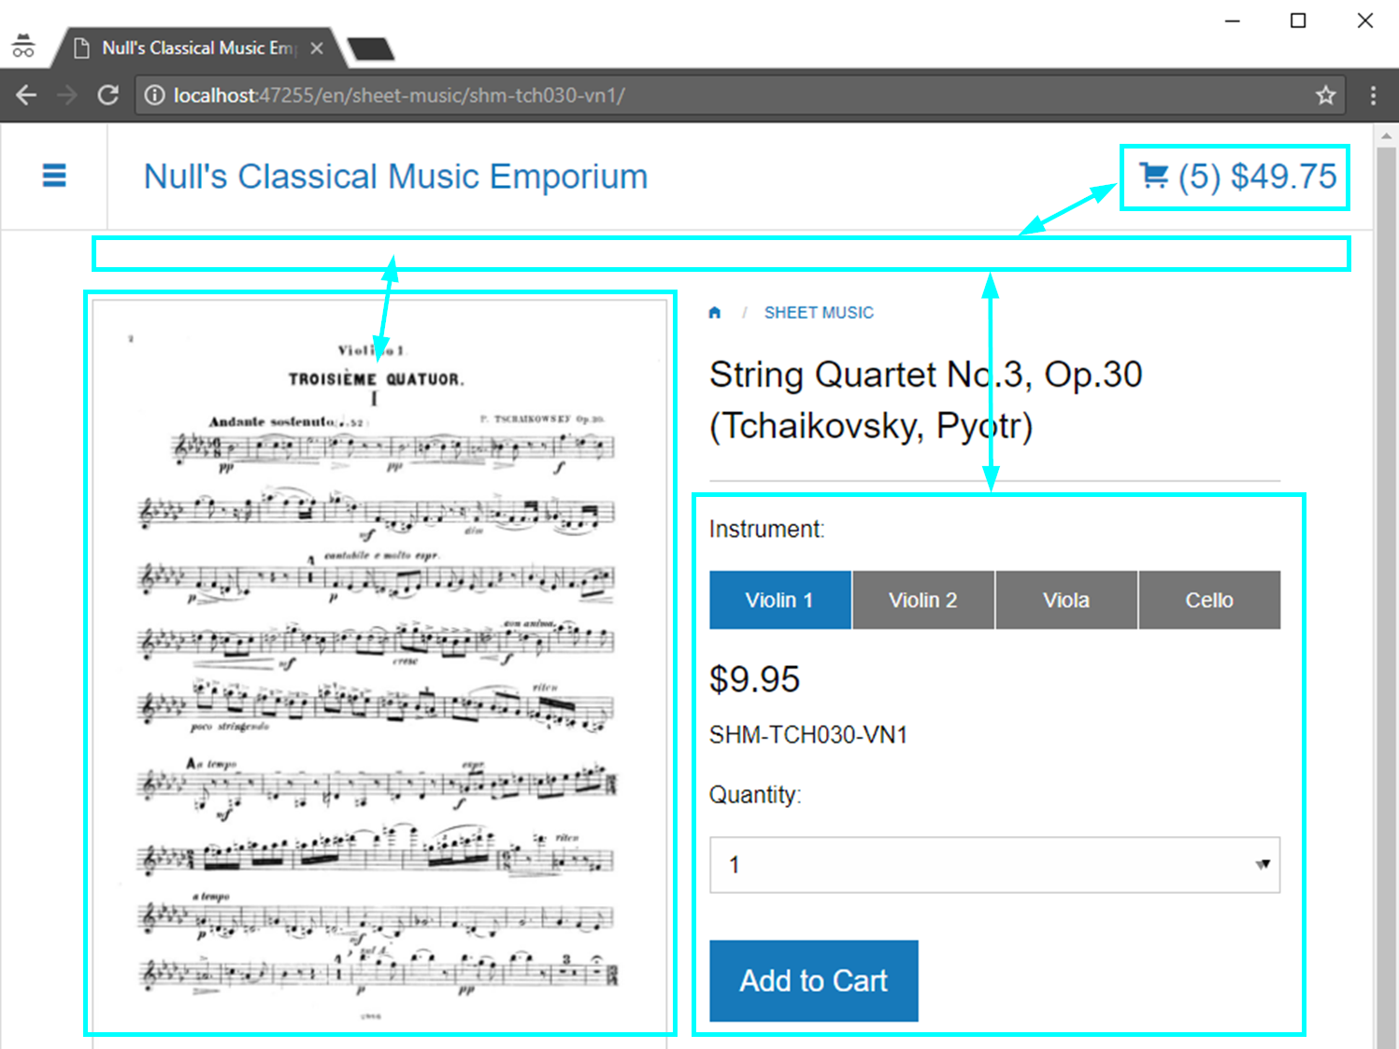

Slide 38
(code)

Slide 39
☹
☺
☺

Slide 40
Lots of baked in capabilities
--
Takes over the DOM
Steep learning curve
Easily wraps over Razor
Familiar feel to Angular-1 and KO
Doesn’t break OPE
Short learning curve
Do use Portals with Episerver
Do carefully split Razor from React
Doesn’t break OPE
Medium learning curve

Slide 41
github.com/drewnull/javascript-episerver-ope

